Slide 1

Linux System Administration and Configuration
Module Number: 01
Module Name: Introduction to Linux

Slide 2
Installation of “Red Hat Enterprise Linux (RHEL) 7.0”
Red Hat, Inc. the largest company in Open Source world, released their major enterprise products – RHEL 7.0 – Red Hat Enterprise Linux, designed for modern datacenters, new cloud platforms and big data.
Requirements:
An active Red Hat subscription to download RHEL 7.0 ISO image from Red Hat Customer Portal.
RHEL 7.0 Binary DVD ISO image
Although RHEL can be installed on a variety of platforms, such as AMD 64, Intel 64, IBM System Z, IBM Power, etc.

Slide 3
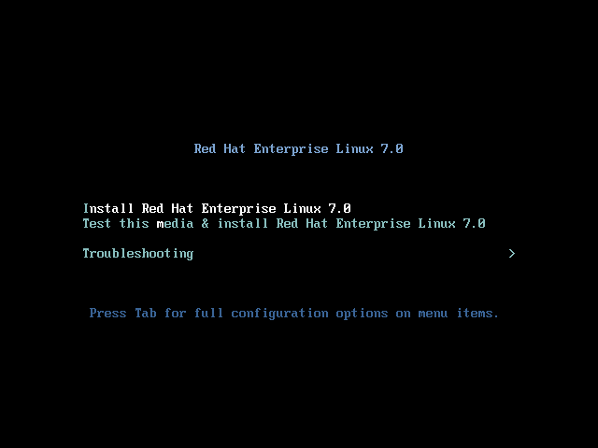
(Continued) Installation of “Red Hat Enterprise Linux (RHEL) 7.0”
Step1: After registering on Red Hat Customer Portal go to Download section and grab the last version of RHEL DVD Binary ISO image, then burn it to a DVD media or create a USB bootable media.
Step2: Then place the DVD/USB in your appropriate system drive, start your computer, select bootable unit and on the first RHEL prompt select Install Red Hat Enterprise Linux 7.0.

Slide 4
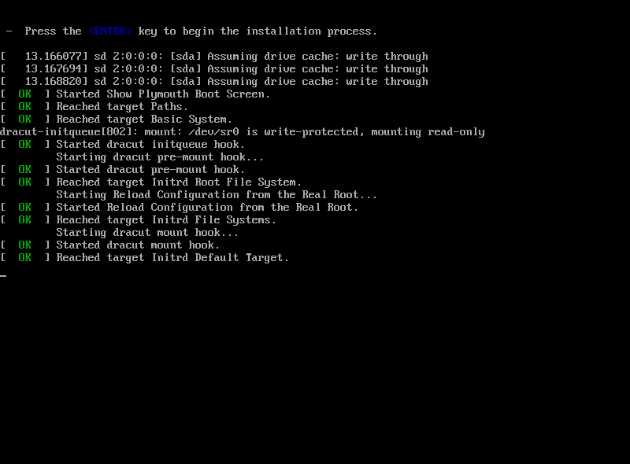
(Continued) Installation of “Red Hat Enterprise Linux (RHEL) 7.0”
As you see, the installation process is initiated.

Slide 5
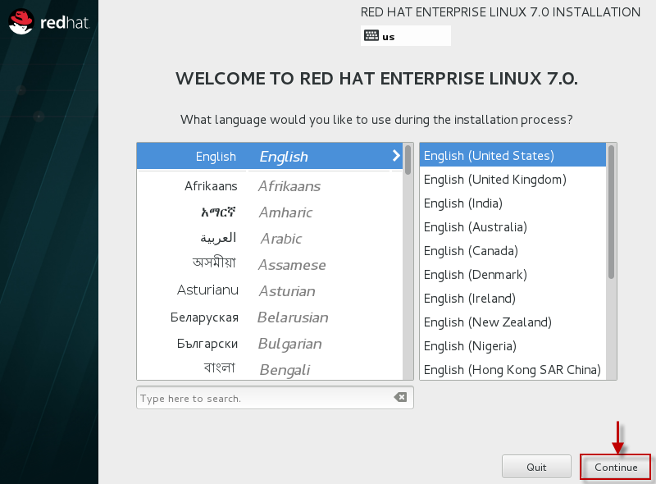
(Continued) Installation of “Red Hat Enterprise Linux (RHEL) 7.0”
Step3: After the system loads, select the language preference for installation process and hit on Continue.

Slide 6
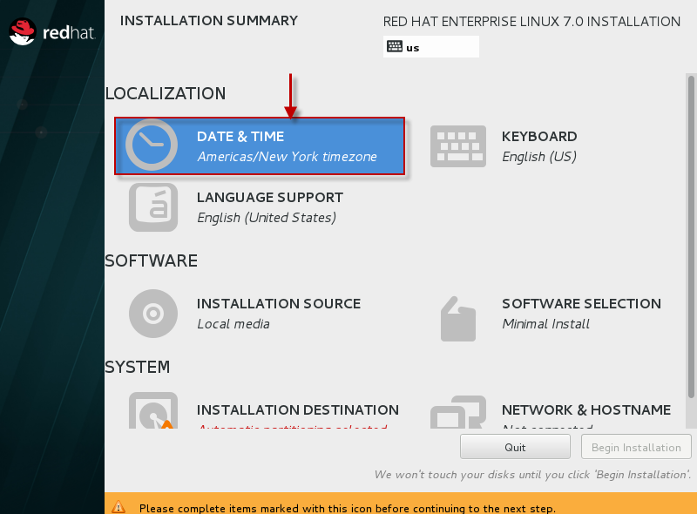
(Continued) Installation of “Red Hat Enterprise Linux (RHEL) 7.0”
Step4: When the installer gets on Installation Summary it’s time to customize the installation process. First click on Date & Time, choose your system location from the provided map and hit on Done to apply configuration.

Slide 7
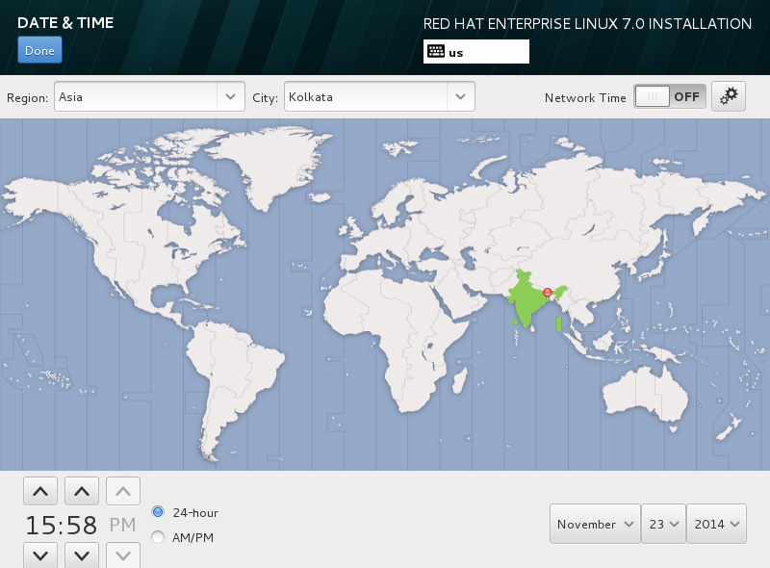
(Continued) Installation of “Red Hat Enterprise Linux (RHEL) 7.0”
Step5: Select your Location.

Slide 8
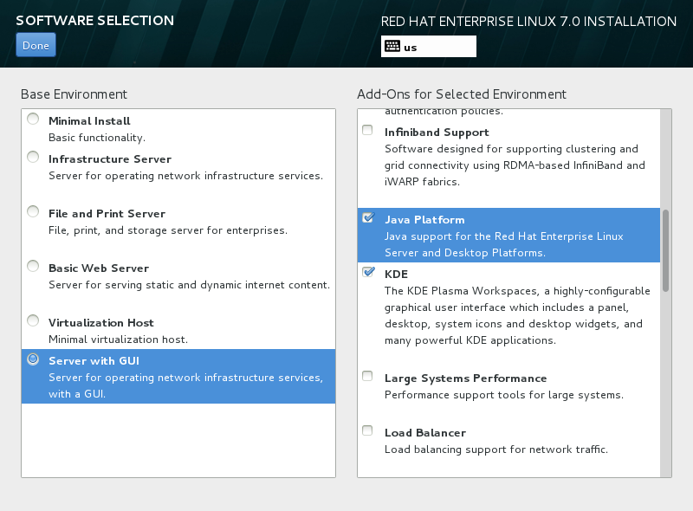
(Continued) Installation of “Red Hat Enterprise Linux (RHEL) 7.0”
Step6: Next we will select the packages which we want to install.
So Select "Software Installation" which will lead you to the below screen.
In this case we will install the "Base Installation" package having "Server with GUI" and in case you want to add any extra Add On, you can select the same from the left panel as shown in the screenshot.

Slide 9
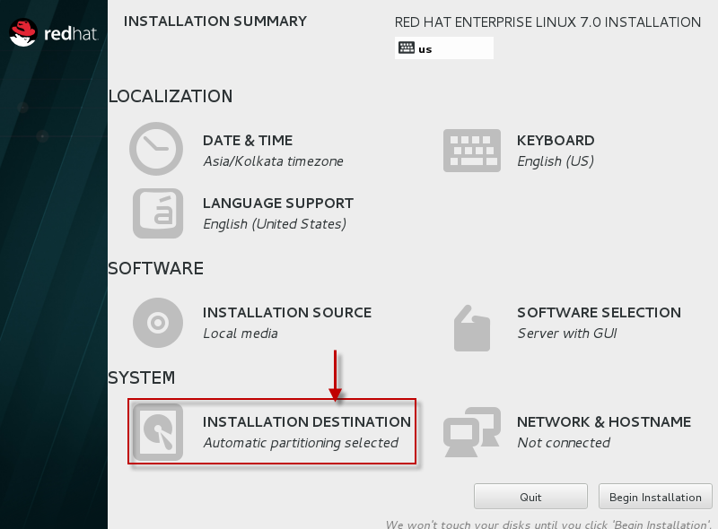
(Continued) Installation of “Red Hat Enterprise Linux (RHEL) 7.0”
Step7: Next we need to configure partitions.
So select "Installation Destination"

Slide 10
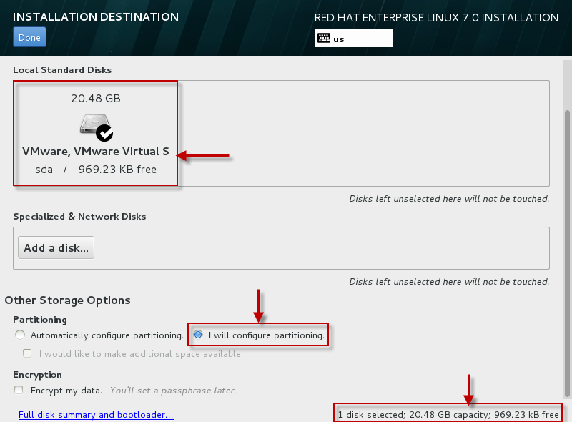
(Continued) Installation of “Red Hat Enterprise Linux (RHEL) 7.0”
Step8: Select the hard disk on which you have used to install RHEL 7, as for this case as you can see 20GB hard drive.
Also if you want the OS to automatically create the partition select the same or else for this article lets manually create the partitions.

Slide 11
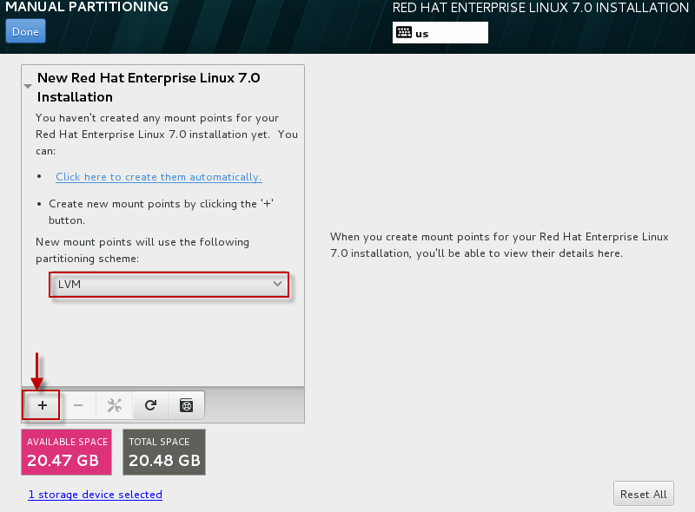
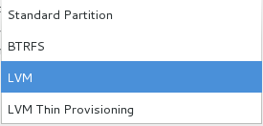
(Continued) Installation of “Red Hat Enterprise Linux (RHEL) 7.0”
You can create a partition with the below list of partition types. As for this article we will select LVM
Step9: Click on the "+" sign to add new partition.

Slide 12
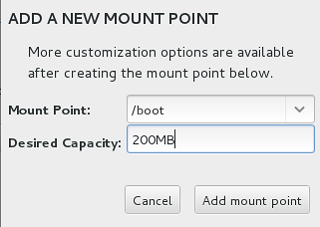
(Continued) Installation of “Red Hat Enterprise Linux (RHEL) 7.0”
Step10: For this article we will create /boot, /, swap partition under LVM with Volume Group name as "VolGroup00"
Step11: Change the partition type to Ext4 as by default XFS will be selected for every partition you create.

Slide 13
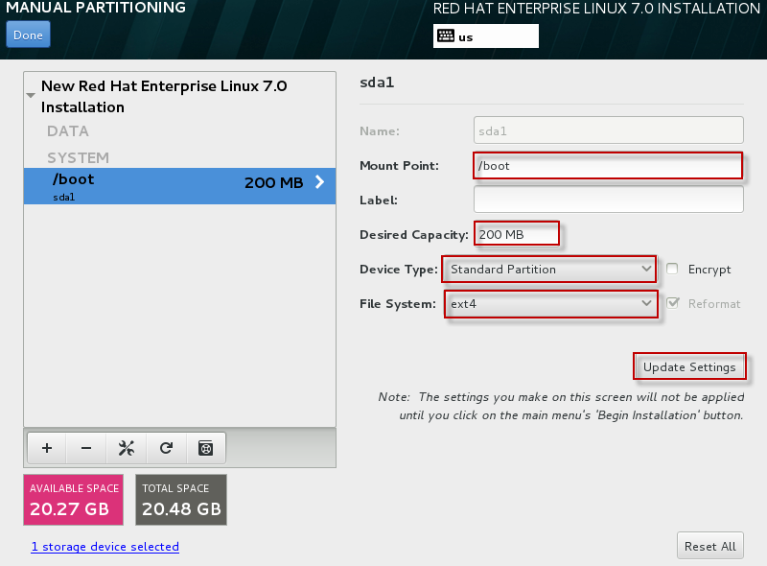
(Continued) Installation of “Red Hat Enterprise Linux (RHEL) 7.0”
Step12: Once you change these settings make sure you "update settings".

Slide 14
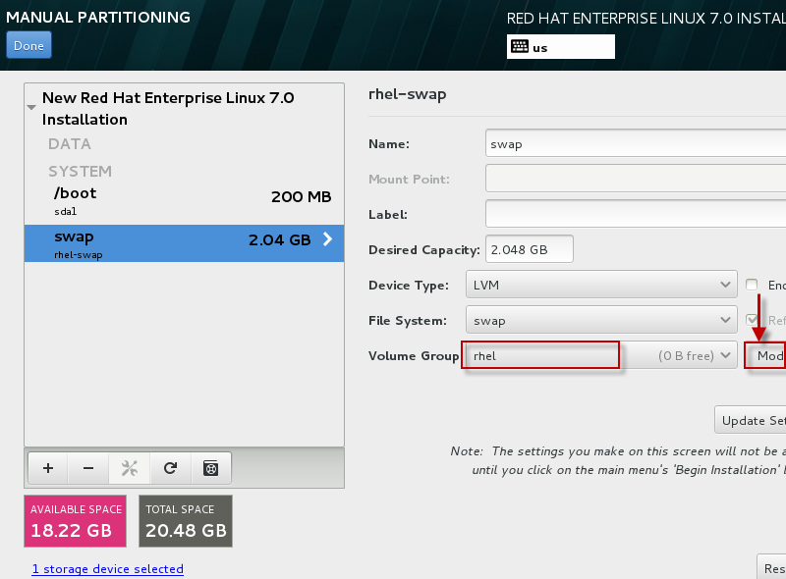
(Continued) Installation of “Red Hat Enterprise Linux (RHEL) 7.0”
Step13: By default Volume Group name is "rhel". Let us change it to "VolGroup00”.

Slide 15
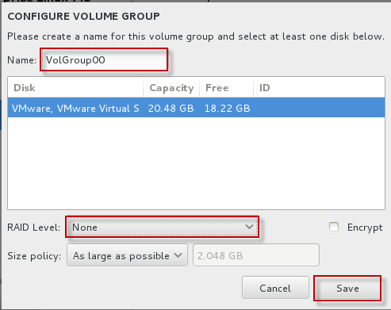
(Continued) Installation of “Red Hat Enterprise Linux (RHEL) 7.0”
Step14: You can also configure the storage for RAID but let us skip that part as of now.

Slide 16
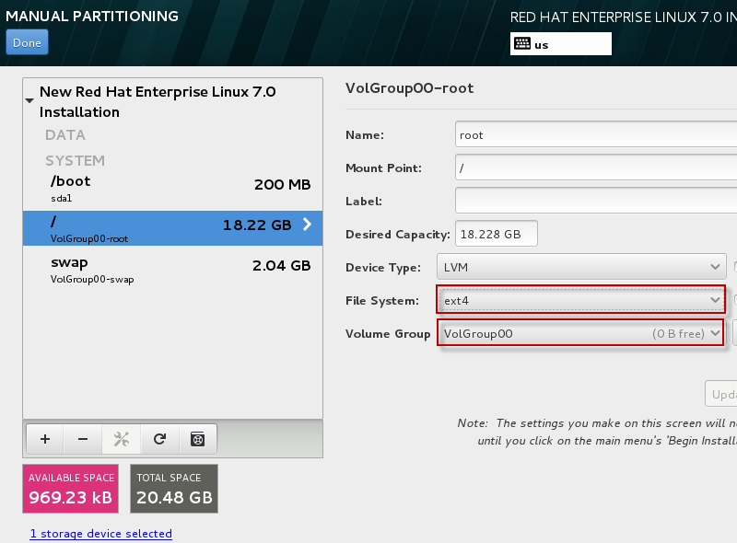
(Continued) Installation of “Red Hat Enterprise Linux (RHEL) 7.0”
Step15: As you see all the mount points as planned are created with below name under LVM
VolGroup00-root
VolGroup-swap

Slide 17
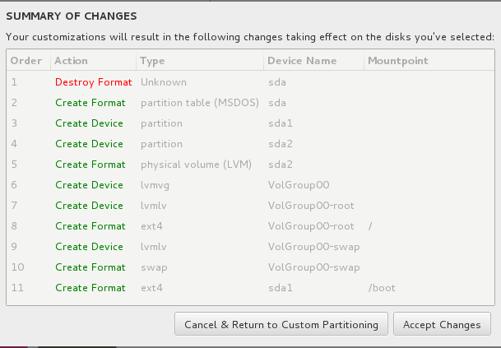
(Continued) Installation of “Red Hat Enterprise Linux (RHEL) 7.0”
Step16: Click on Done and select Accept Changes.

Slide 18
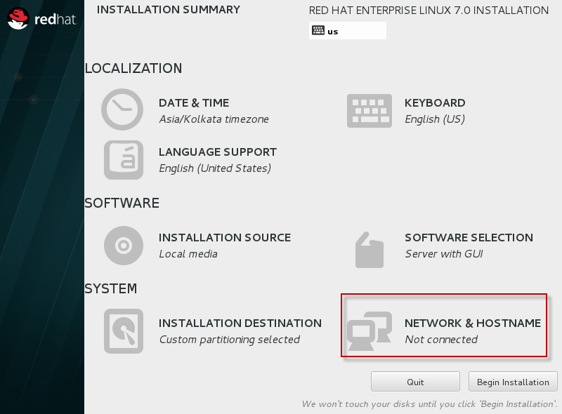
(Continued) Installation of “Red Hat Enterprise Linux (RHEL) 7.0”
Step17: The last one is to Configure Network

Slide 19
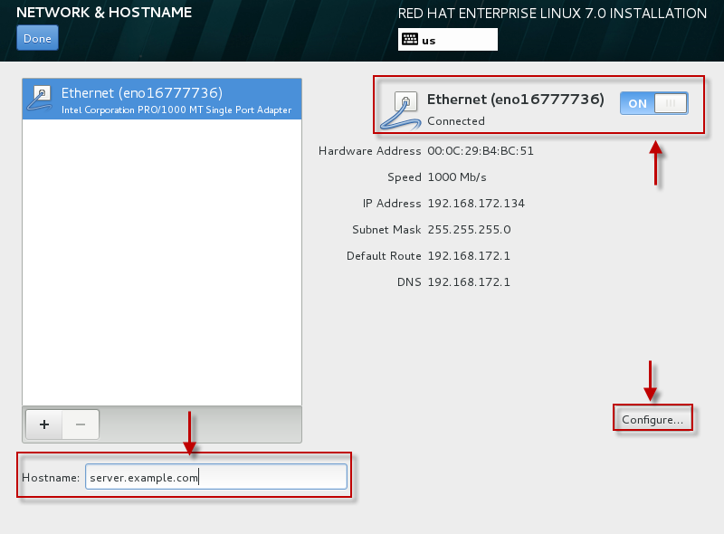
(Continued) Installation of “Red Hat Enterprise Linux (RHEL) 7.0”
Step18: Provide a hostname for your machine and enable the ethernet device. Next select Configure to configure network settings for your machine.

Slide 20
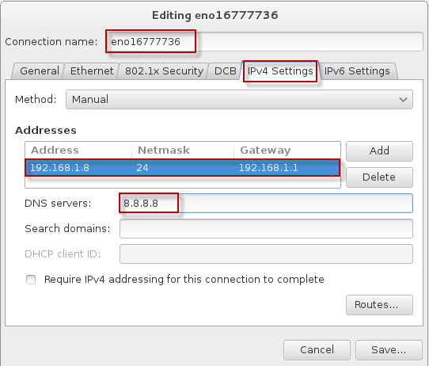
(Continued) Installation of “Red Hat Enterprise Linux (RHEL) 7.0”
Step19: Change the Ethernet device name or else you can skip that part. Next configure you IP details as per your environment i.e., IPv4 or IPv6. We are using IPv4 so selected the "IPv4 Settings" and added the IP, Netmask, Gateway and DNS details in the same.. Click on "Done" to save the configuration and go a step back.

Slide 21
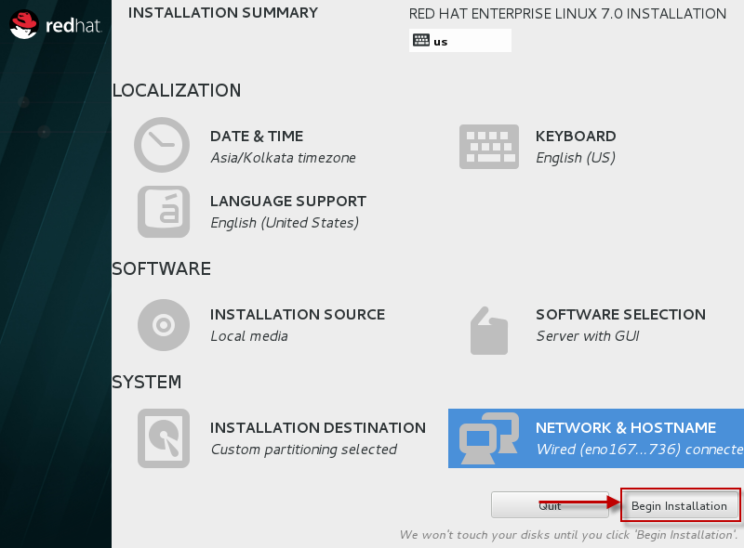
(Continued) Installation of “Red Hat Enterprise Linux (RHEL) 7.0”
Step20: So we are done here with all the options on this screen. Next we can "Begin Installation"

Slide 22
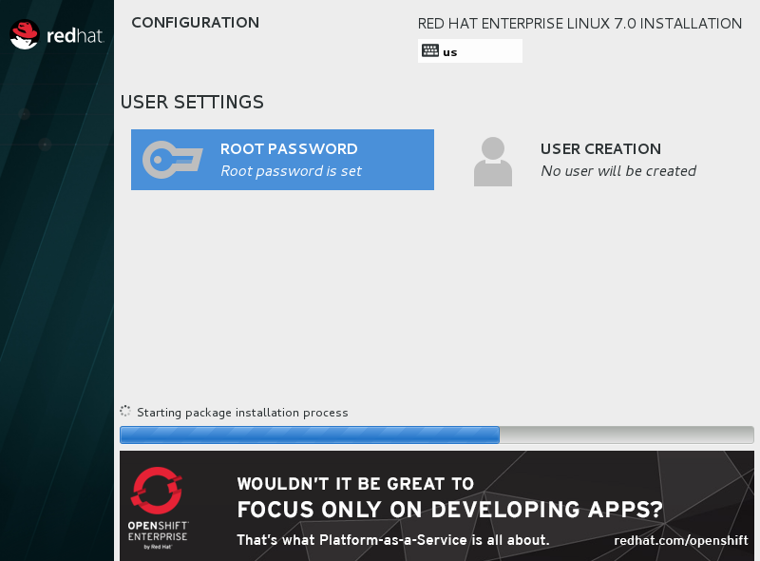
(Continued) Installation of “Red Hat Enterprise Linux (RHEL) 7.0”
Step21: As you see the installation has begun, in the mean time you can add a password for your root user. Also you can create additional user by using the "User Creation" thumbnail.

Slide 23
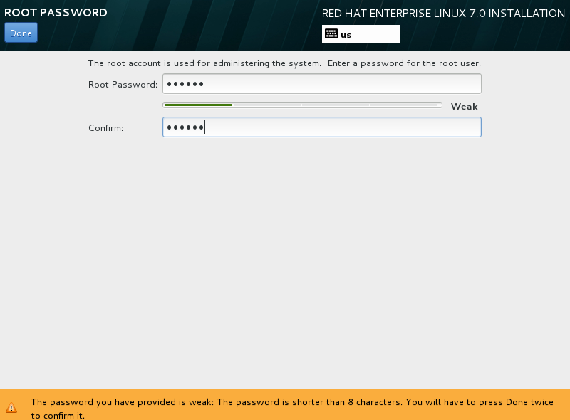
(Continued) Installation of “Red Hat Enterprise Linux (RHEL) 7.0”
Step22: Provide a password for root account.

Slide 24
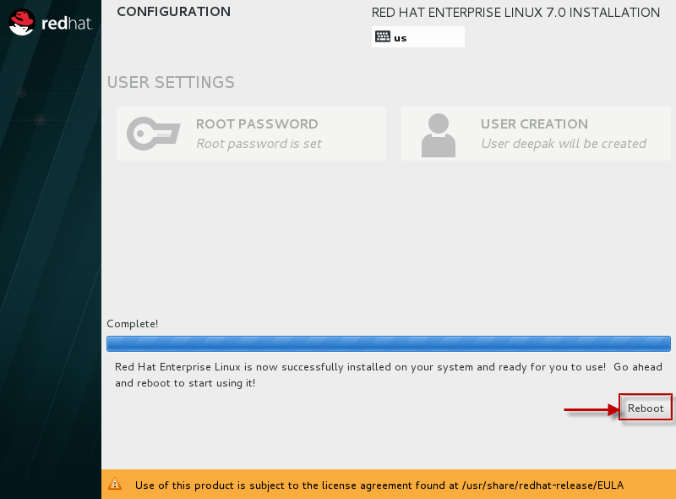
(Continued) Installation of “Red Hat Enterprise Linux (RHEL) 7.0”
Step23: In the mean time let the installation be completed. Once done click on Reboot.

Slide 25
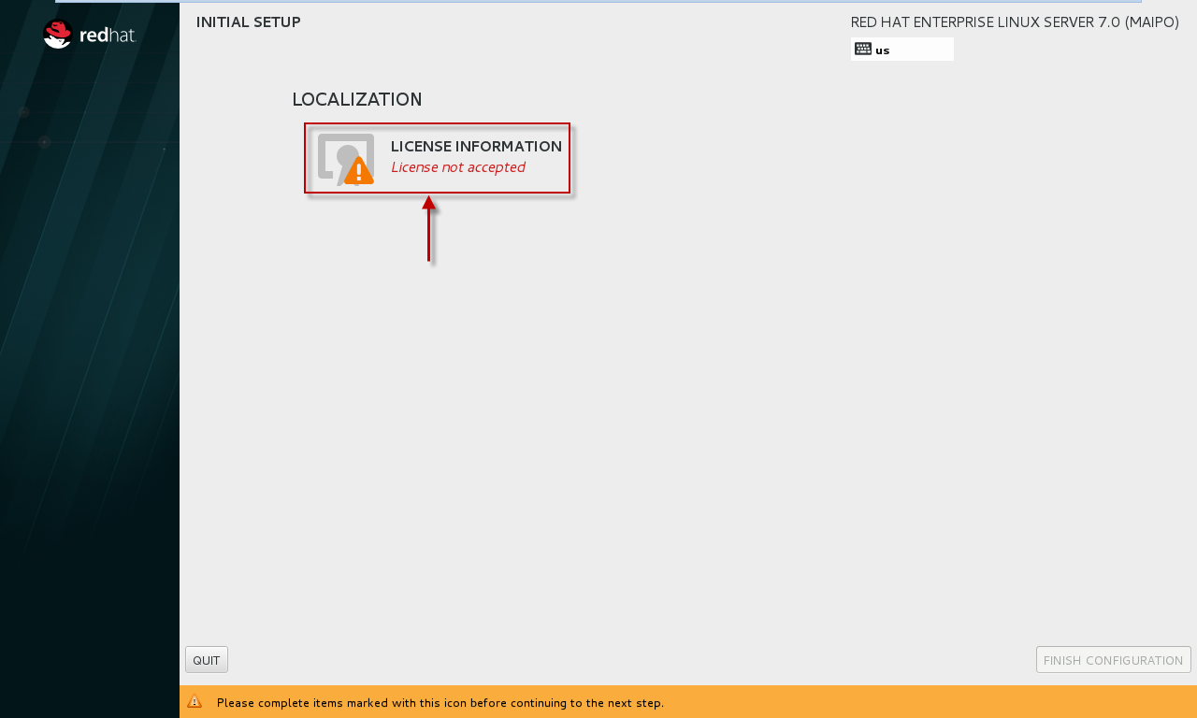
(Continued) Installation of “Red Hat Enterprise Linux (RHEL) 7.0”
Step24: Once the machine reboots, next it will prompt the below screen. Click on "License Information“.

Slide 26
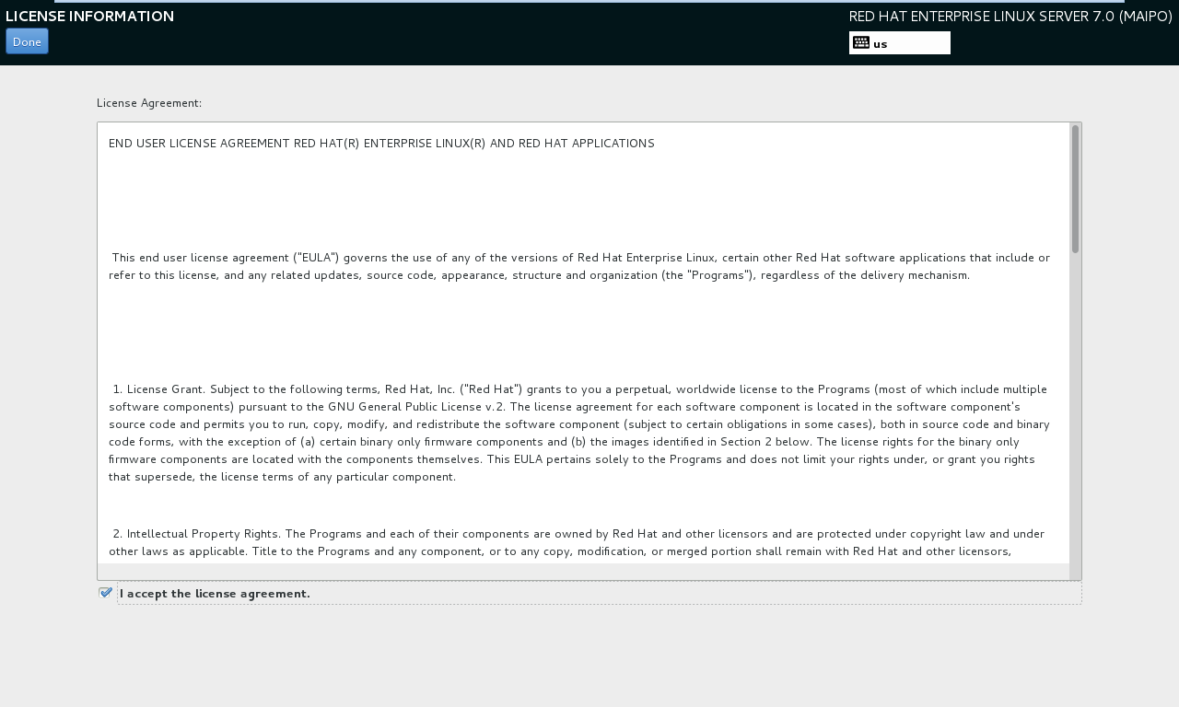
(Continued) Installation of “Red Hat Enterprise Linux (RHEL) 7.0”
Step25: Accept the Terms and Conditions.

Slide 27
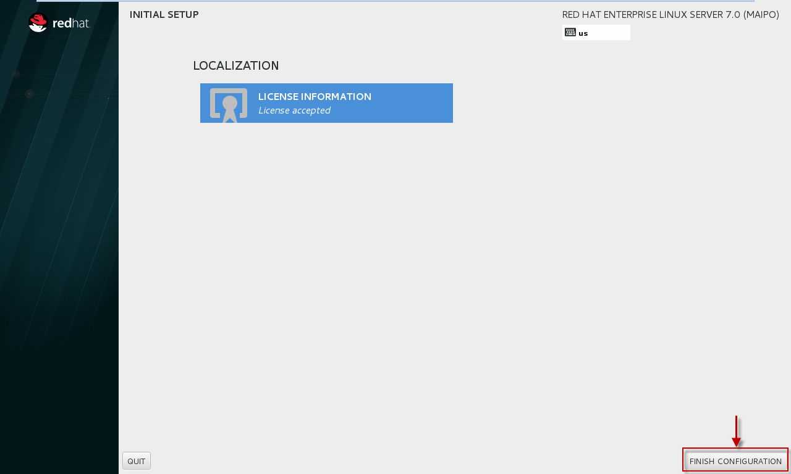
(Continued) Installation of “Red Hat Enterprise Linux (RHEL) 7.0”
Step26: Click on "Finish Configuration"

Slide 28
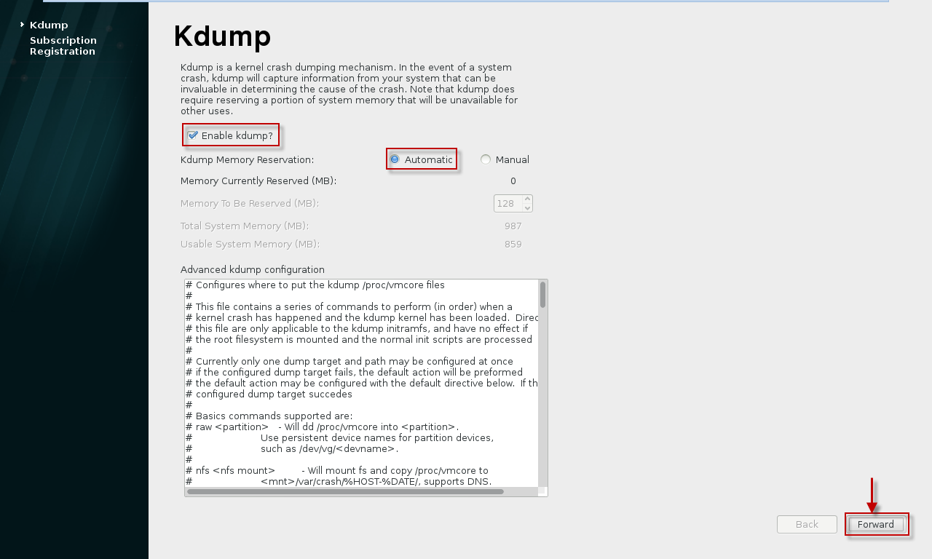
(Continued) Installation of “Red Hat Enterprise Linux (RHEL) 7.0”
Step27:
Next, you will get the Kdump configuration page.
Let us enable the Kdump and let the machine decide the amount of memory required for the same.

Slide 29
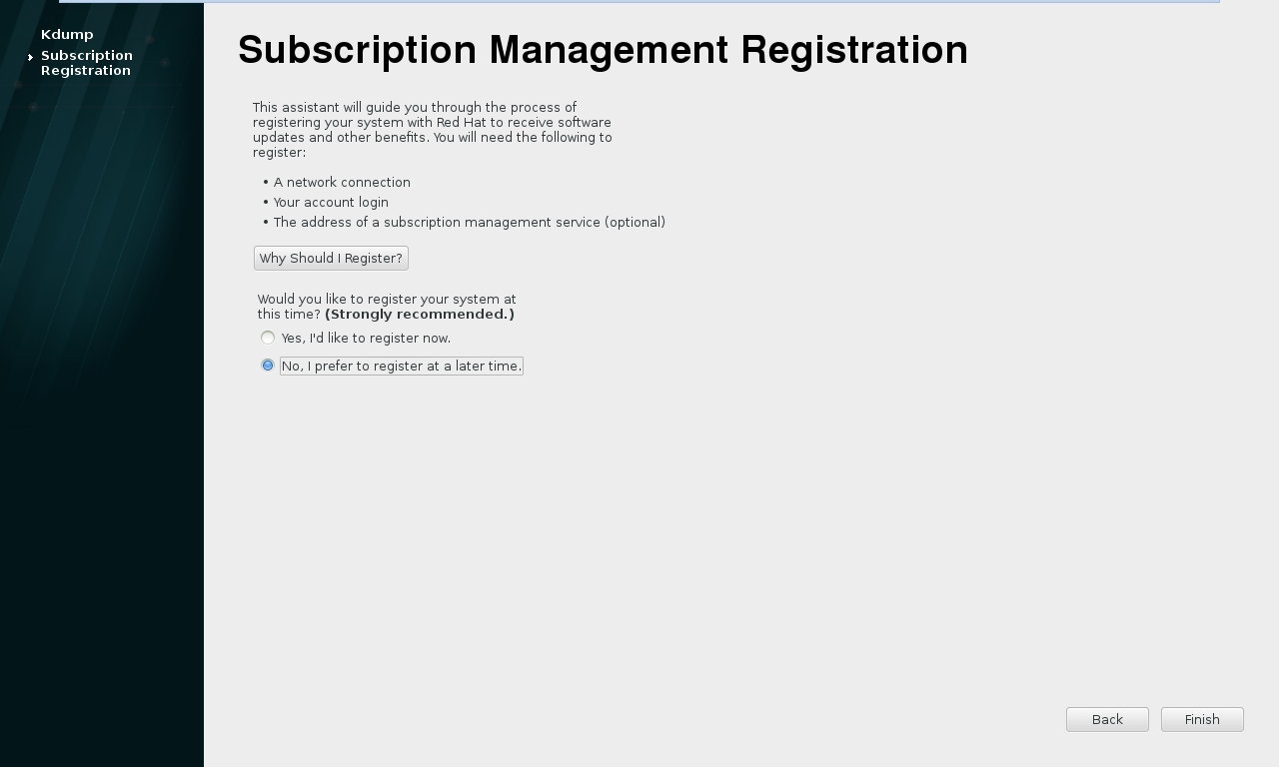
(Continued) Installation of “Red Hat Enterprise Linux (RHEL) 7.0”
Step28: I do not want to register my system to RHN as for now, also we can perform this step later so let us skip this part for now.

Slide 30
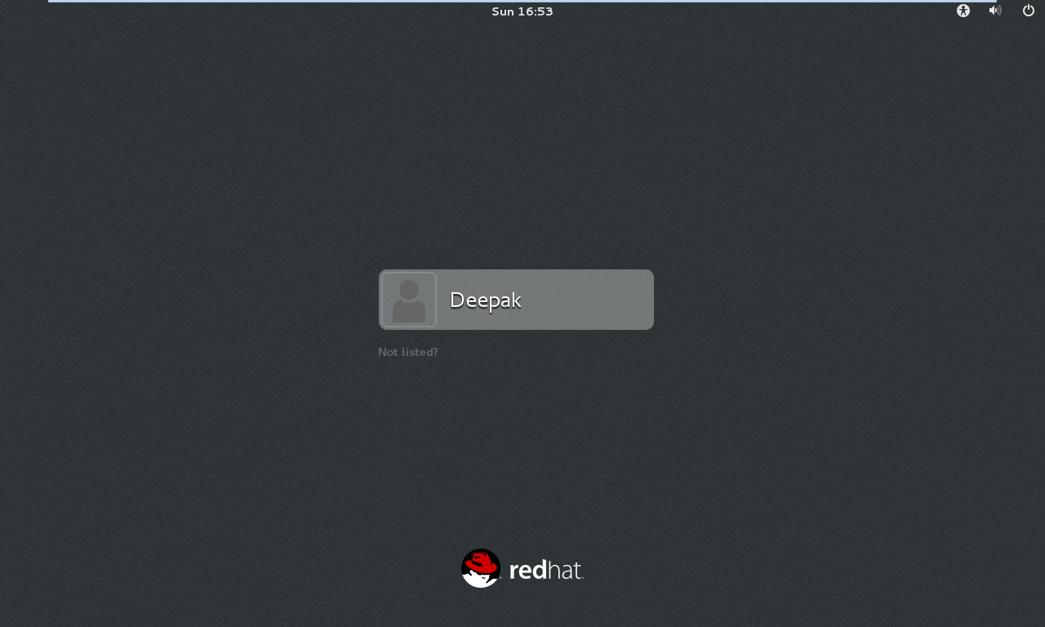
(Continued) Installation of “Red Hat Enterprise Linux (RHEL) 7.0”
Step29:
Next you get your Login Screen which means we have successfully installed our Operation System i.e. RHEL 7.0 (64 bit).

